Slide 1



What Makes You Do Stuff?
The Psychology of Motivation
Arthur Doler
@arthurdoler
arthurdoler@gmail.com

Slide 2





































TITANIUM SPONSORS
Platinum Sponsors
Gold Sponsors

Slide 3
Disclaimer

Slide 4
Topics in this presentation will involve large-scale, sweeping, and disruptive policies and methodologies including but not limited to: compensation, benefits, time tracking, bonuses, flex time, team composition, management structure, hiring, firing, reviews, incentives, tasking, policies, and culture.
Detailed discussion and potentially positive commentary by the presenter about any of these topics beyond the scope of single developers or an immediate project team should not necessarily be taken as suggestion of, agitation for, recommendation for, or demand for the initiation of these policies in the context of your larger team structure or your company as a whole (though the presenter might be happy to have those conversations later).
Void where prohibited. No purchase necessary. Offer valid only in the continental United States and Canada. Burn after reading. No representation or warranty, express or implied, with respect to the completeness, accuracy, fitness for a particular purpose, or utility of these materials or any information or opinion contained herein. Actual mileage may vary. Prices slightly higher west of the Mississippi. All models over 18 years of age. No animals were harmed during the production of this product. Any resemblance to actual people, living or dead, or events, past, present or future, is purely coincidental. Some names have been changed to protect the innocent. This product is meant for educational purposes only. Some assembly required. Batteries not included. Package sold by weight, not volume. Contents may settle during shipment. No user-serviceable parts inside. Use only as directed.

Slide 5
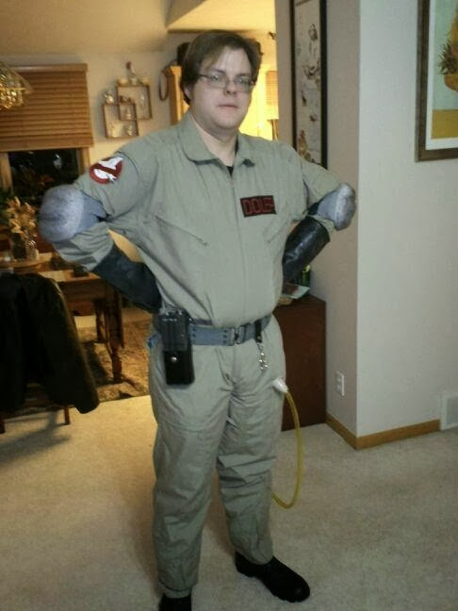
Who the heck are you?
12-Year Software Developer
ADHD and Generalized Anxiety Disorder
Psychology and Neuroscience Enthusiast
NOT A PSYCHOLOGIST

Slide 6
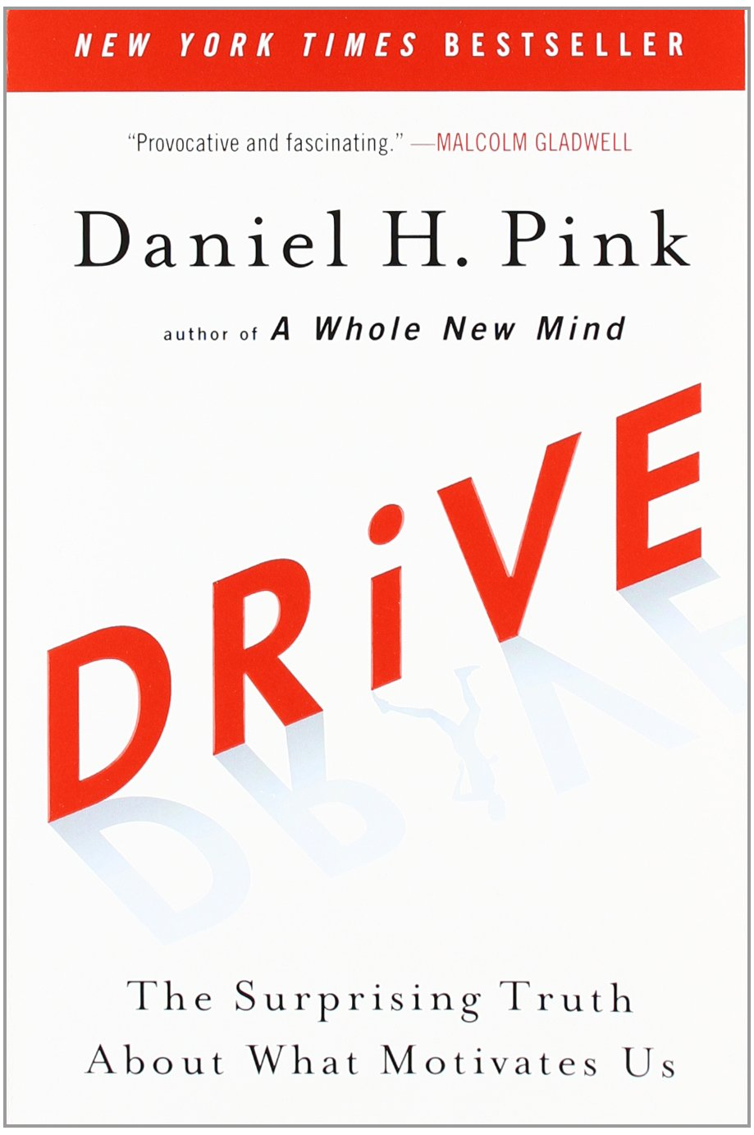
Source: Amazon

Slide 7
Motivation is a really vague term.

Slide 8
What we’re solving here
Clarifying what the word motivation even means
Discovering why you work the way you do
Discovering why others work the way they do
Getting you & your team to engage with your work

Slide 9
Navigating this talk
An Exploration of Motivation
Type I and Type X
Practical Applications

Slide 10
Where does behavior come from?

Slide 11
Motivation
Input
Actions
Desires
Needs

Slide 12
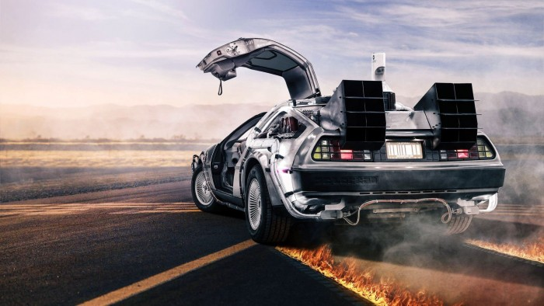
We begin millions of years ago…
Source: ru.epizod.ua

Slide 13

Source: Giphy

Slide 14
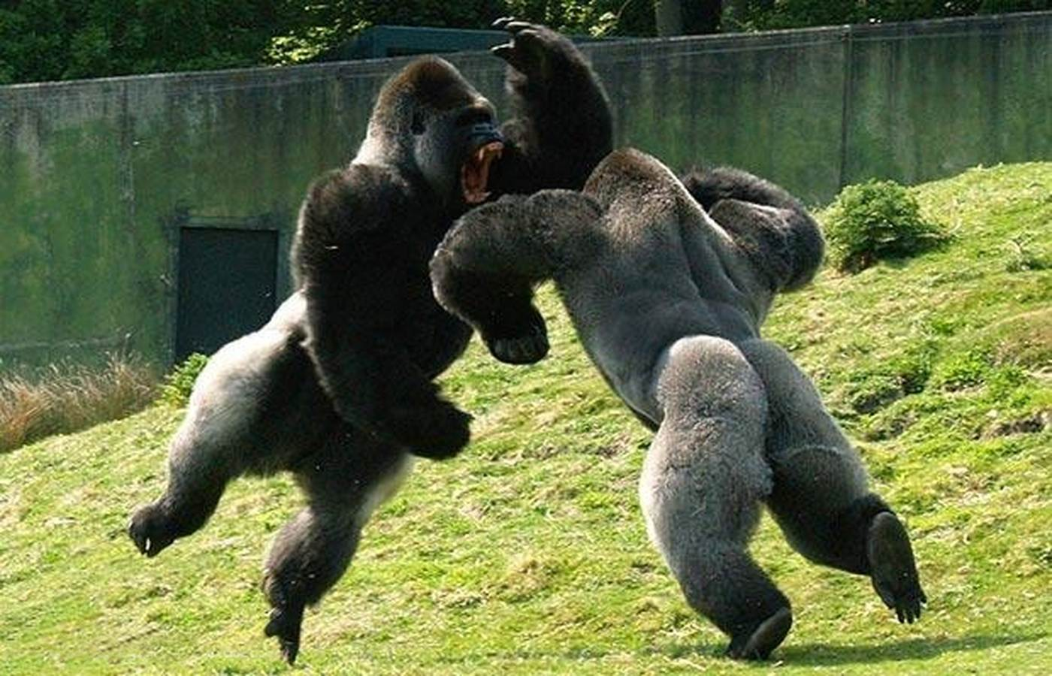
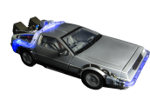
Motivation 1.0
1,000,000,000 BCE ~ 15,000 BCE
Source: Wikipedia

Slide 15


Hunger
Eating
Thirst
Drinking
Other Bio Needs
CENSORED
Money
Going To Work
Approval
Being Nice

Slide 16
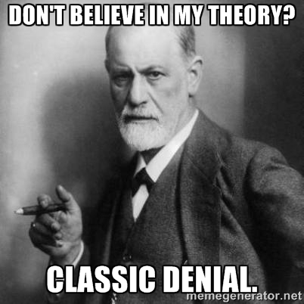
Drive Theory
Circa 1900
Important Names: Freud, Adler, Hull
“The greater the feeling of inferiority that has been experienced, the more powerful is the urge to conquest and the more violent the emotional agitation.”
Source: Wikipedia, Memegenerator
-- Alfred Adler
Notes:
Basis of psychoanalysis
Innate drives to perform behaviors
Prevented behaviors lead to sublimation

Slide 17
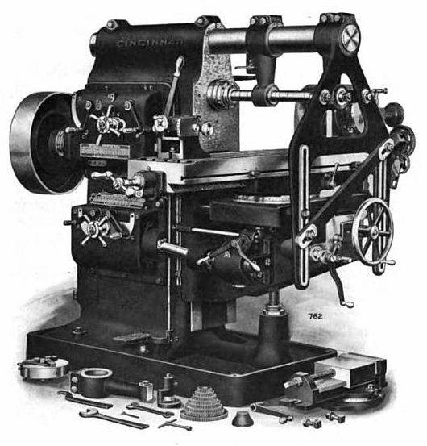
Motivation 2.0
15,000 BCE ~ 1950 CE
Source: Wikipedia

Slide 18

More of the Behavior
Reward
Behavior
Punishment
Less of the Behavior

Slide 19
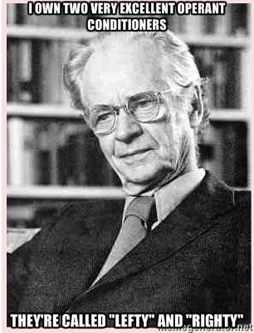
Behaviorist Theory
Circa 1940
Important Names: Pavlov, Skinner, Linehan
“The consequences of an act affect the probability of its occurring again.”
-- B.F. Skinner
Source: Wikipedia, Memegenerator
Notes:
Basis of psychoanalysis
Innate drives to perform behaviors
Prevented behaviors lead to sublimation

Slide 20
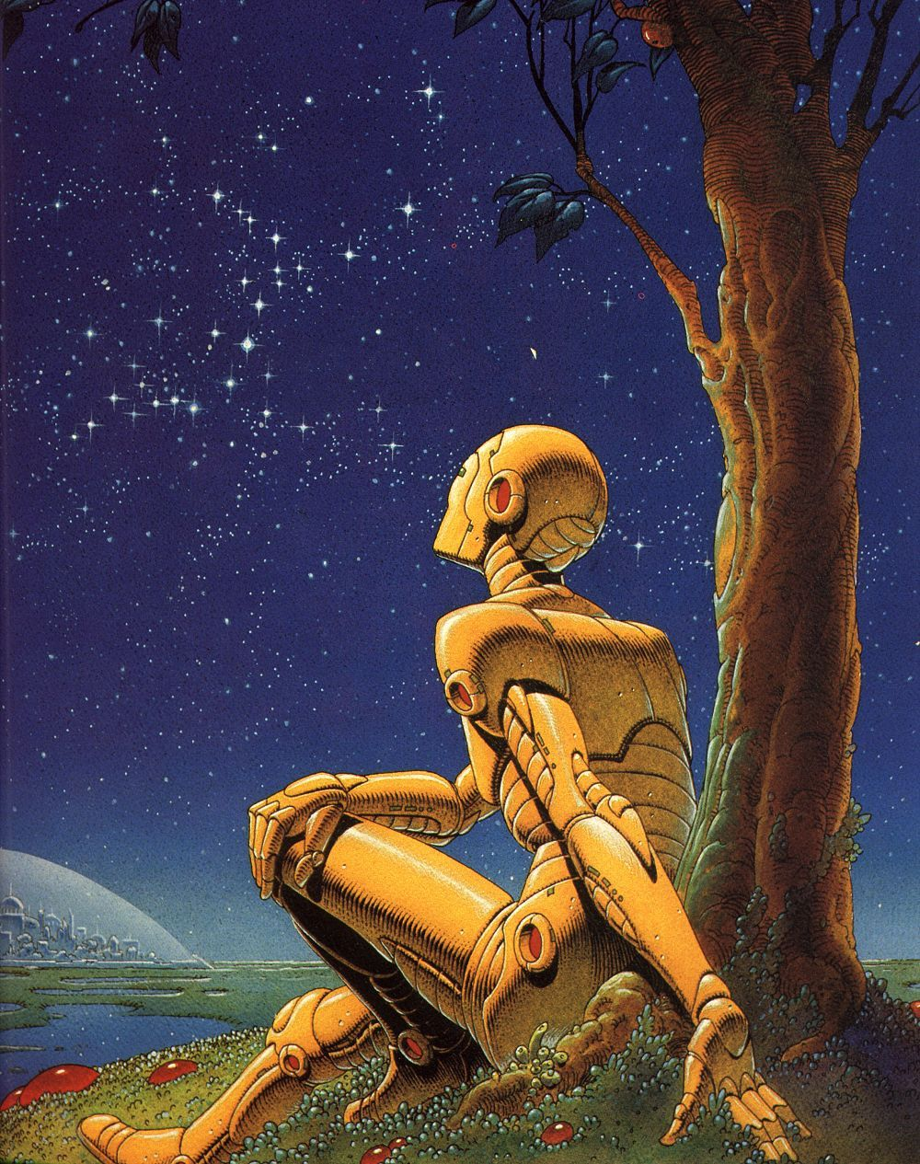
Motivation 2.1
1950 CE ~ 1970 CE
Source: Wikipedia

Slide 21

Personal Growth
Achievement
Enjoyment
Job Security
Working Conditions
Pay

Slide 22
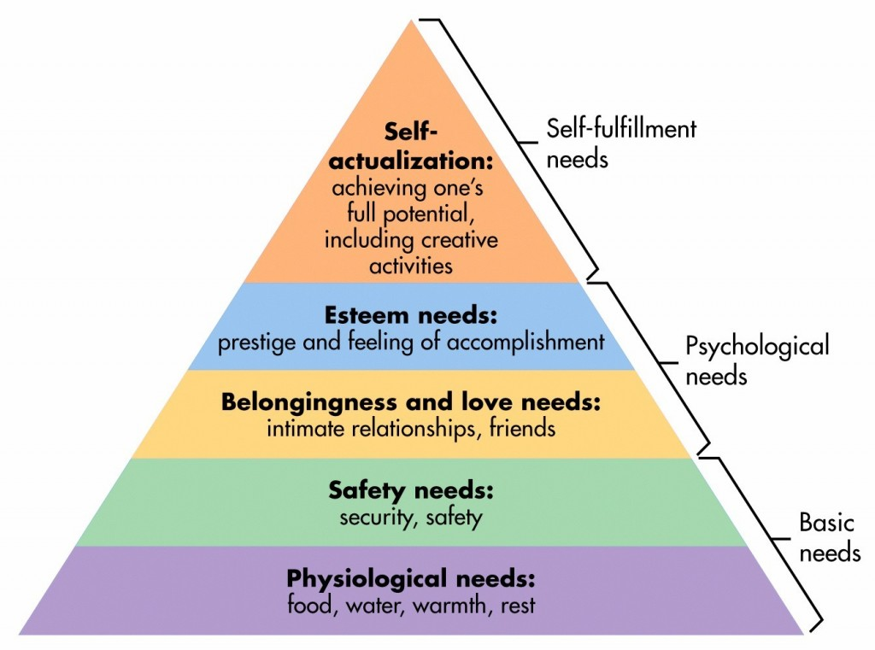
Source: Wikipedia

Slide 23
Hygiene Factors
Motivators
Money
Safety
Job security
Etc.
Growth potential
Personal achievement
Recognition
Etc.

Slide 24
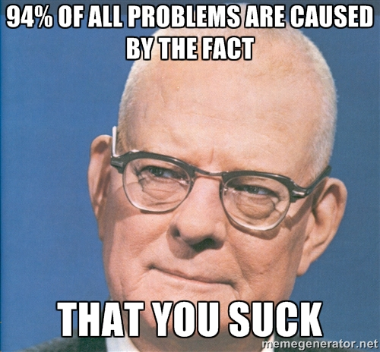
System of Profound Knowledge (also lots of other names)
Circa 1950
Important Names: Deming, McGregor, Herzberg
“If you want people to do a good job, give them a good job to do.”
-- Frederick Herzberg
Source: Wikipedia, Memegenerator
Notes:
Basis of psychoanalysis
Innate drives to perform behaviors
Prevented behaviors lead to sublimation

Slide 25
All these models suck.

Slide 26
Strike One – Edward Deci, 1971

Slide 27
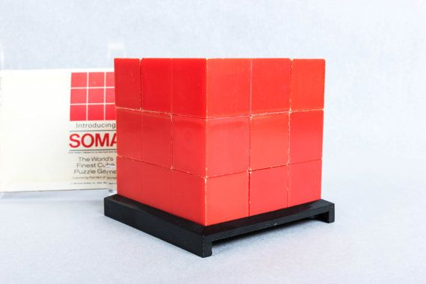
Source: Wikipedia

Slide 28
Participants assemble 2 configurations
Deci leaves to “get a fourth configuration”
Secretly watches participants for 8 minutes
What do they do?
 | Test | Control
Day 1 | No reward | No reward
Day 2 | Reward | No reward
Day 3 | No reward | No reward

Slide 30
Strike Two – Lepper and Greene, 1973

Slide 31




Slide 32
Two weeks later…

Slide 34
Strike Three – Glucksberg, 1964

Slide 35
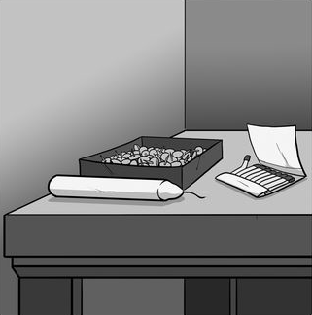
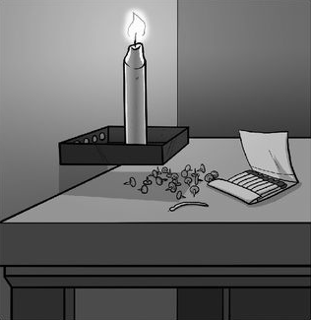
Source: Wikipedia
Control Group – No reward
Test Group – $20.00 for the best time, $5 for the top 25%

Slide 37
Humans aren’t just irrational…
We’re predictably irrational.
Notes:
Why? Our brains are designed to take cognitive shortcuts
Optimizations to reduce effort

Slide 38
Glucksberg, Take Two

Slide 39
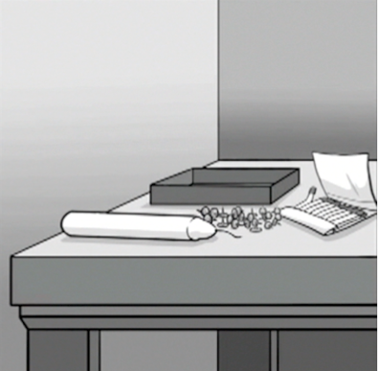
Source: Wikipedia
Control Group – No reward
Test Group – $20.00 for the best time, $5 for the top 25%

Slide 41
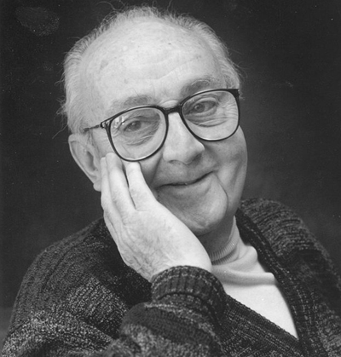
“…all models are wrong,
but some are useful.”
– George E.P. Box,
“Robustness in the strategy of
scientific model building”
Source: Wikipedia
Notes:
These models are useful in some contexts.
But in other contexts they are actively harmful.

Slide 42
Tasks
Algorithmic
Heuristic
Structured
Constrained
Repetitive
Designed
“Solvable”
Unstructured
Open-ended
Creative
Evolving
“Unsolvable”

Slide 43
Question time!
What is “Work”?
Notes:
Why? Our brains are designed to take cognitive shortcuts
Optimizations to reduce effort

Slide 44
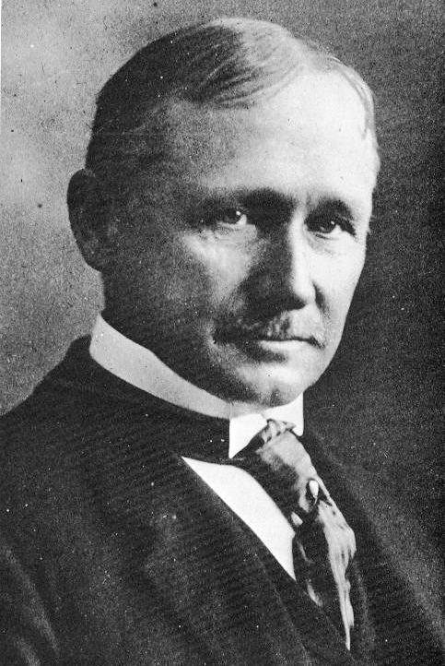
“Work consists mainly of simple, not particularly interesting, tasks. The only way to get people to do them is to incentivize them properly and monitor them carefully.”
– Frederick Winslow Taylor
Source: Wikipedia

Slide 45
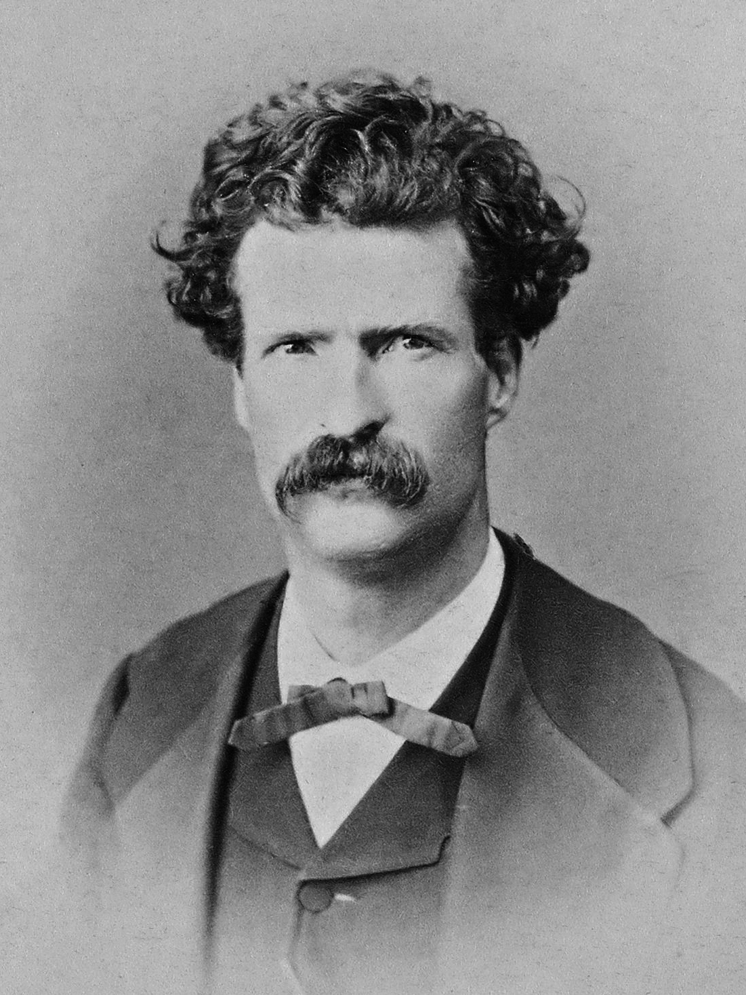
“Work consists of whatever a body is obliged to do, and … Play consists of whatever a body is not obliged to do.”
– Mark Twain,
“Tom Sawyer”
Source: Wikipedia

Slide 46
Question time!
Do humans fundamentally dislike work?
Notes:
Why? Our brains are designed to take cognitive shortcuts
Optimizations to reduce effort

Slide 47
How different are jobs from the 1940s and jobs today?

Slide 48
What’s the new model?

Slide 49

Motivation 3.0
Source: Wikipedia
1970 CE ~ ?

Slide 50

Algorithmic Behavior
Predictable Change
Extrinsic Stimuli
More/Better of the Behavior
Intrinsic Stimuli
Heuristic Behavior
Less/Worse of the Behavior
Extrinsic Stimuli

Slide 51
Now-That
If-Then

Slide 52
Extrinsic Motivators applied to Heuristic Tasks
Increased short-term performance… mostly
Decreased long-term performance
Cloud judgement
Cause myopic thinking
Narrow both depth and breadth of problem-solving
The larger the reward, the worse the effects

Slide 53
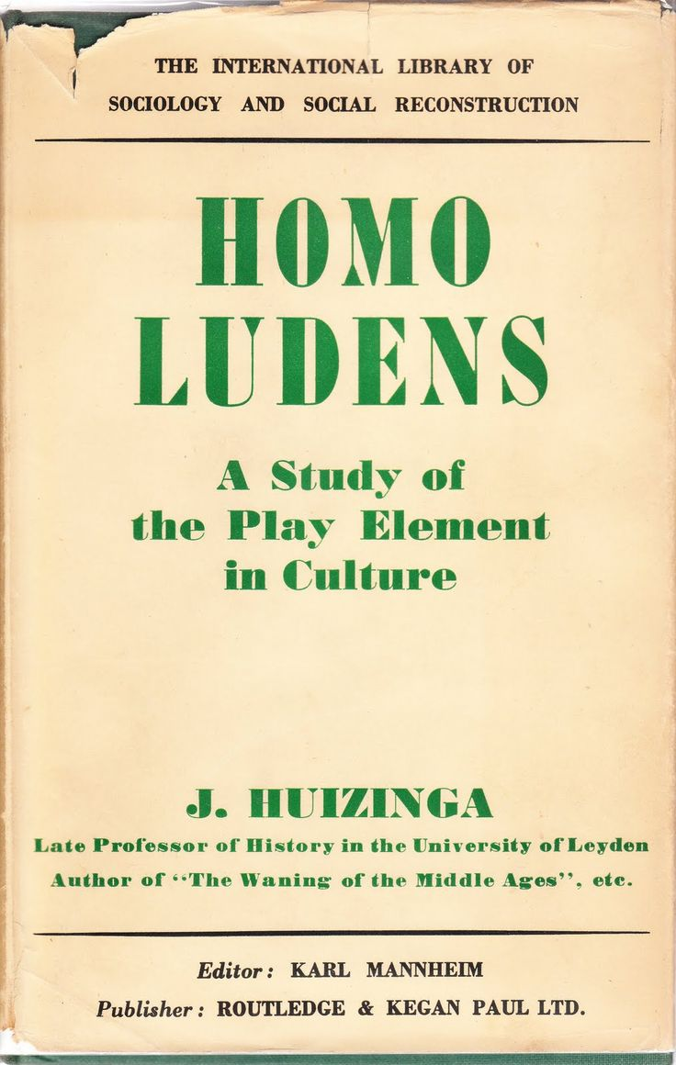
Source: Amazon

Slide 54
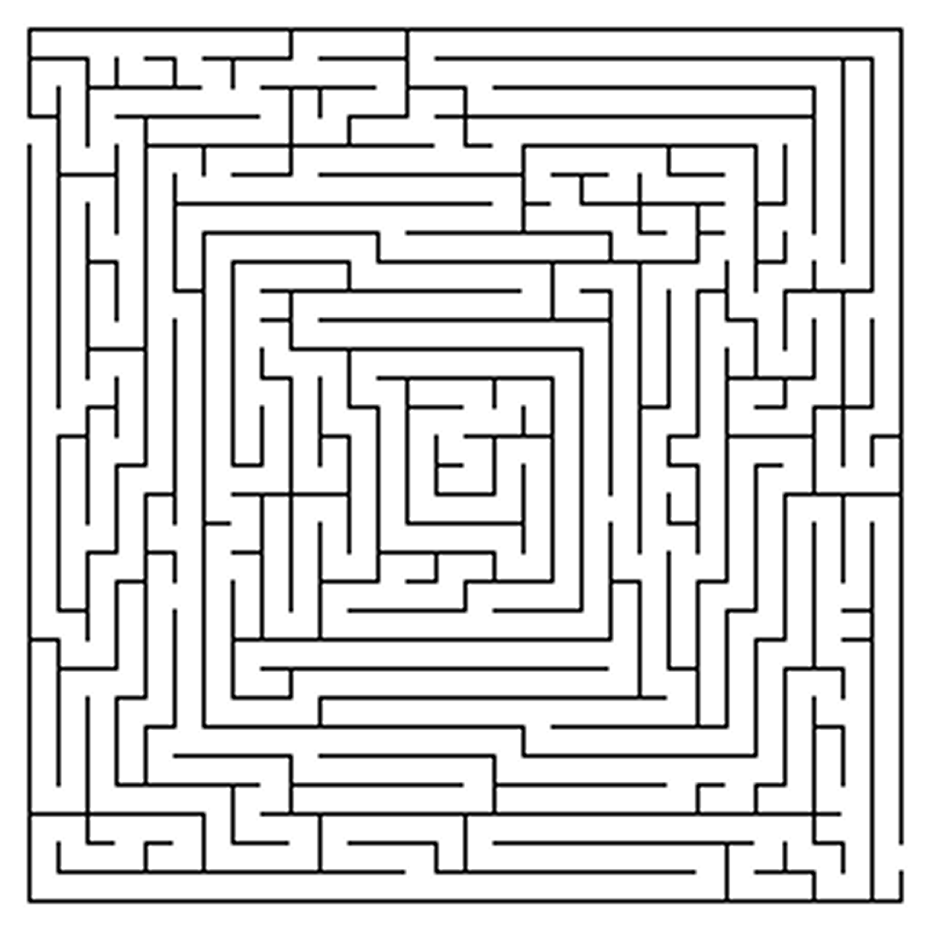
Start
And so on…
Employee of the Month
Quota
$500

Slide 55
Daniel Pink’s Model Type I and Type X

Slide 56
Type I
Type X
Motivation 3.0
Both born and made
Performs best in the long run
Renewable resource
Money is a hygiene factor
Tend to be internally focused
Motivation 2.0
Both born and made
Performs best in the short run
Exhaustible resource
Money is the end goal
Tend to be externally focused

Slide 57
The Components of Type I

Slide 58
Autonomy
Self-Directed
Mastery
Devoted to improvement
Purpose
Connected to a larger goal

Slide 59
Autonomy
“I control that which I am responsible for.”

Slide 60
“Autonomous motivation involves behaving with a full sense of volition and choice, whereas controlled motivation involves behaving with the experience of pressure and demand that comes from forces perceived to be external to the self.”
– Edward L Deci and Richard M Ryan,
“Self-Determination Theory and the Facilitation of Intrinsic Motivation, Social Development, and Well-Being”

Slide 61
The Four Ts
Task
Time
Technique
Team

Slide 62
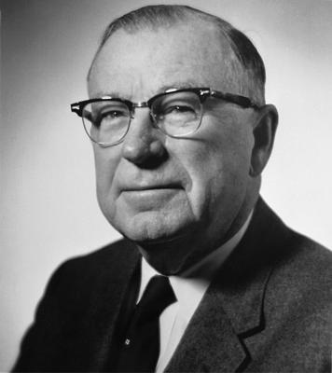
“Hire good people and
leave them alone.”
– William McKnight,
3M Chairman ~1930-1940
Source: Wikipedia

Slide 63
Mastery
“I strive to explore and become better.”

Slide 64
Engagement
Mastery
Autotelic experiences
“Auto” = Self
“Telic” = Goal

Slide 65
The Three Laws of Mastery
Mastery is a Mindset

Slide 66
Entity Theory
Incremental Theory
Intelligence is a fixed trait
Therefore:
Exertion signifies a personal limit
Choosing harder goals risks failure, which implies less intelligence
An “unsolvable” problem means you should give up
Intelligence is trainable
Therefore:
Exertion signifies improvement
Choosing harder goals increases your mastery
An “unsolvable” problem becomes a guidepost for learning
Fixed Mindset
Growth Mindset

Slide 67
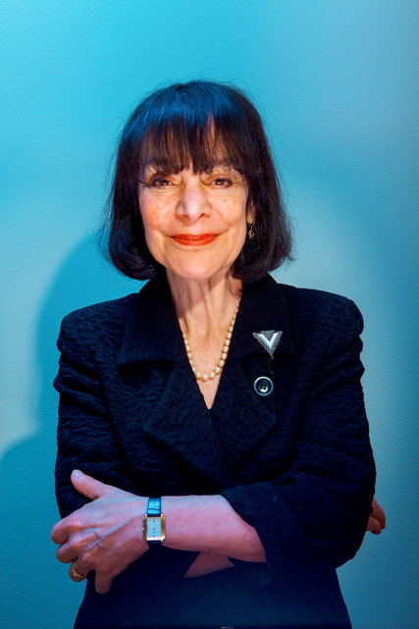
“So what should we say when children complete a task—say, math problems—quickly and perfectly? Should we deny them the praise they have earned? Yes. When this happens, I say, ‘Whoops. I guess that was too easy. I apologize for wasting your time. Let’s do something you can really learn from!’”
― Carol S. Dweck, Mindset: The New Psychology of Success
Source: NYT

Slide 68
The Three Laws of Mastery
Mastery is a Mindset
Mastery is a Pain

Slide 69
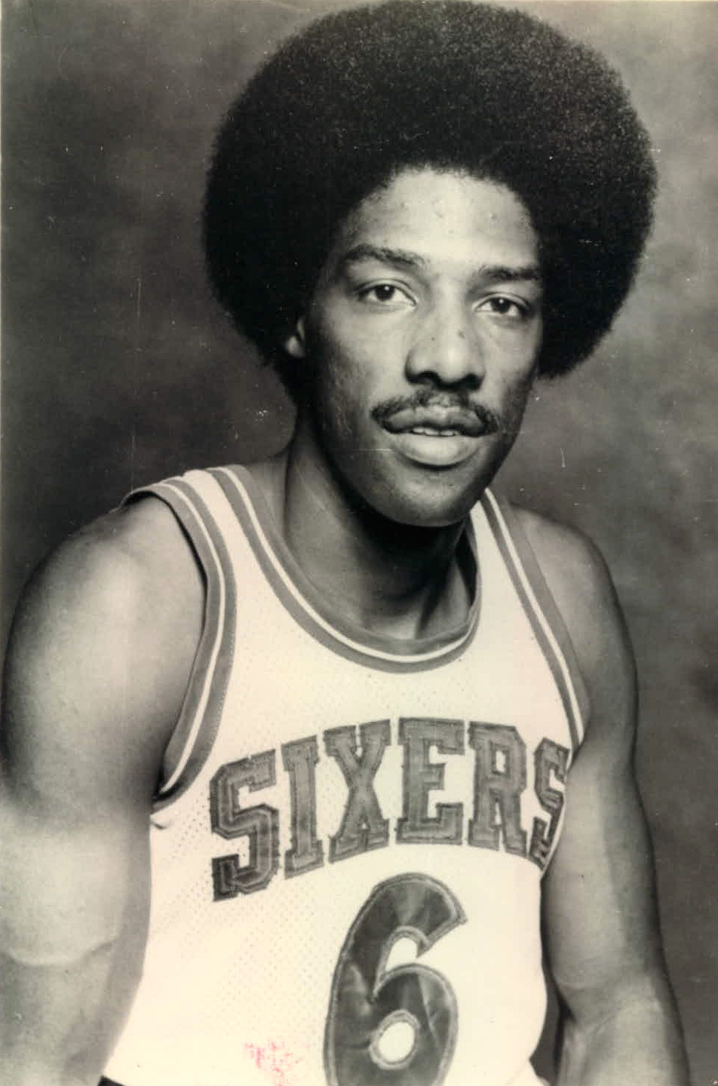
“Being a professional is doing the
things you love to do on the days
you don’t feel like doing them.”
– Julius Erving
Source: Wikipedia
Notes:
Requires long hours (see “10,000 hours” quote) with little improvement, effort, work

Slide 70
The Three Laws of Mastery
Mastery is a Mindset
Mastery is a Pain
Mastery is an Asymptote

Slide 71
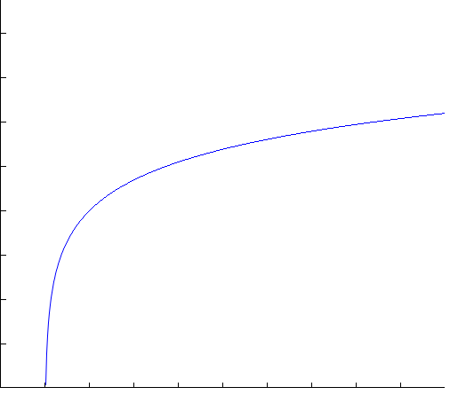

Slide 72
Purpose
“I want my work to serve something that matters.”

Slide 73
Purpose provides a context for mastery and autonomy
Purpose is the “Why?” behind a job
Purpose-oriented goals are better than money-oriented goals for Type I

Slide 74
So what do I do with all that?

Slide 75
Question time!
Are you Type I?
Do you want to be?

Slide 76
Type I motivators aren’t all universal
Learning Control Outcome
Creation Enjoyment
Type I behaviors aren’t all universal

Slide 77
Beware Imitators!
“Empowerment”
The Oz Principle
Over-focus on “The Team”

Slide 78
How do we promote Type I?

Slide 79
General

Slide 80
Identify your and your team’s Types
Type I is contagious!
Don’t be Punished by Rewards
Use feedback, not praise

Slide 81
Hiring, Firing, and Measuring

Slide 82

“Passion”
“Drive”

Slide 83
Make your teams diverse
Pay fairly – or more than average
Performance-based pay? Forget it
Be prepared to let people go

Slide 84
Autonomy

Slide 85
Institute paid time for noncommissioned work
Run an anonymous autonomy audit
Practice relinquishing control
Allow selection of project, or at least task

Slide 86
Mastery

Slide 87
Find and use your team’s Goldilocks Zones
Drive out fear from your team
Emphasize effort, not talent
People progress at different paces

Slide 88
Purpose

Slide 89
Know your story
Animate with purpose, don’t motivate with rewards
Do good things!

Slide 90
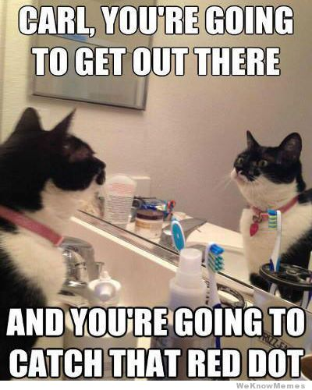
Any Questions?
Source: WeKnowMemes
@arthurdoler
arthurdoler@gmail.com

